Slide 1
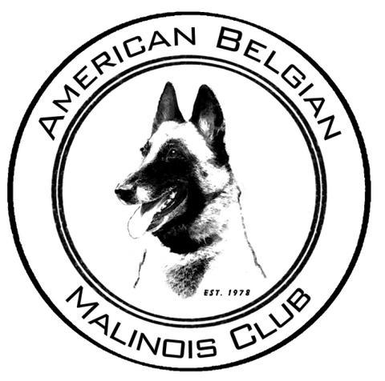
The Belgian Malinois
Presented by
The
American Belgian Malinois Club
©ABMC
Notes:
Welcome
Introductions
Procedure

Slide 2
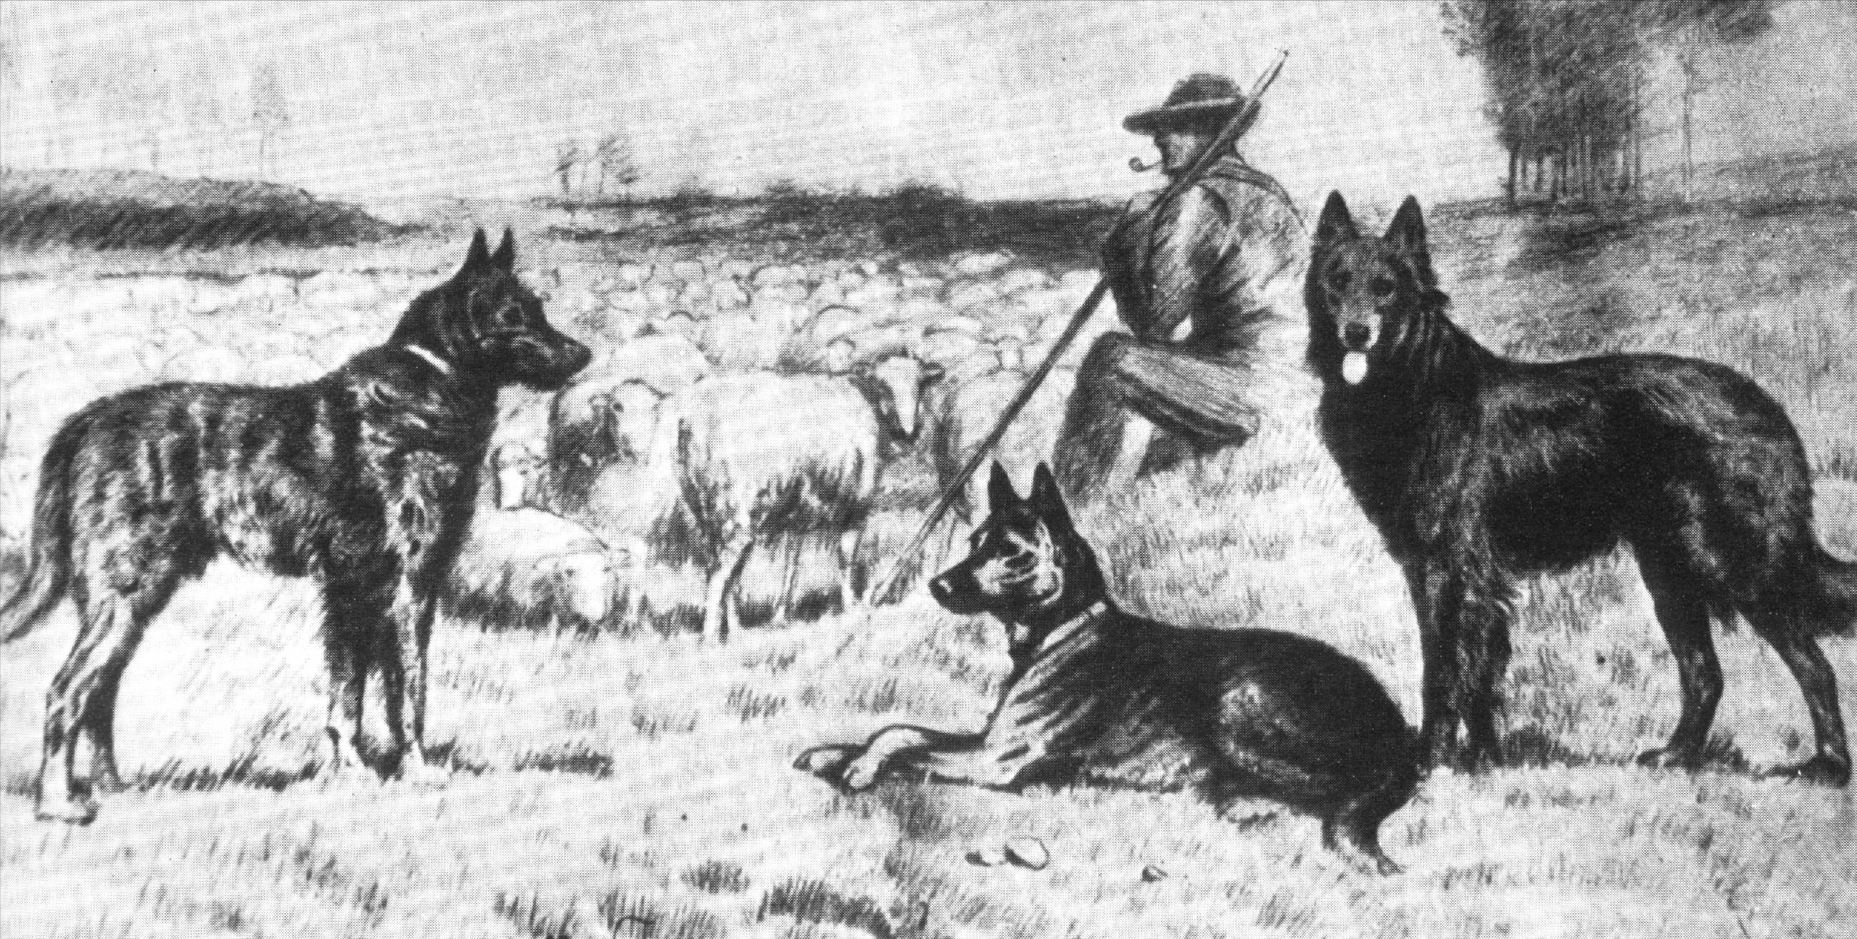
History
Notes:
This is an old painting from 1910. In addition to demonstrating the usefulness of the breed, notice the one obvious characteristic that remains an important part of breed type today – the dogs are square.
The Belgian herder dogs were highly respected for their trainability and helpfulness to the farmers. The breed was officially organized and a breed standard was drawn up in 1892.

Slide 3
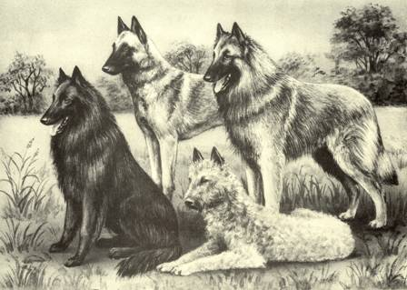
History
1891 - Belgium proclaimed the Berger Belge as a Breed
1892 - The first standard defined 3 coat types; Short, Long and Rough Haired.
Notes:
According to Belgian history, the first dog show was held in 1840 in the town of Tervuren. The Belgian shepherds were shown along with the German and French herders, as “Continental shepherds”. The winner of this show was a Malinois. The Belgian herders were highly respected for their trainability and helpfulness to the farmers. The breed was officially recognized in 1891 and a breed standard was drawn up in 1892.
Learning the history of breeds is important to understanding what attracts many people to the Belgians even today. They are prized for their intelligence, desire to learn, and to work as a partner with their owner, and for their agile efficient working structure. Their beauty is a natural result of their working physique and alert intelligent expression. Belgians are credited as being the first dogs used for police work in Europe.

Slide 4
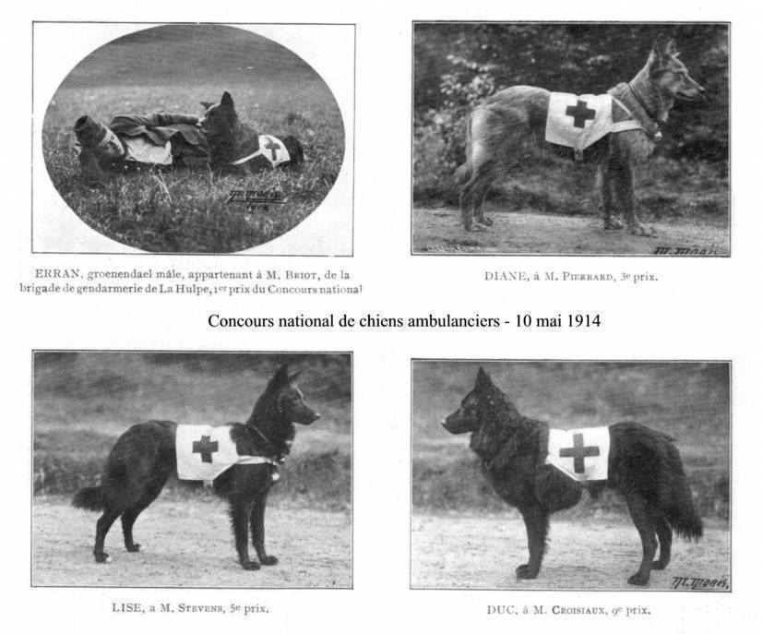

Slide 5
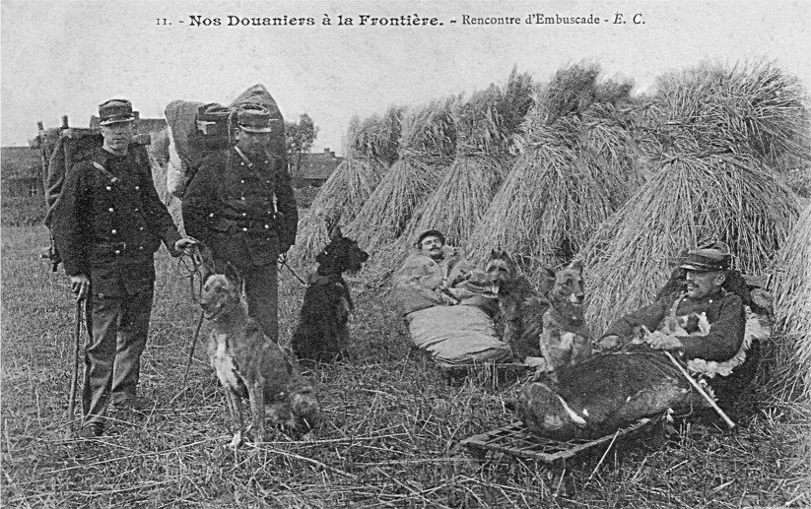

Slide 6
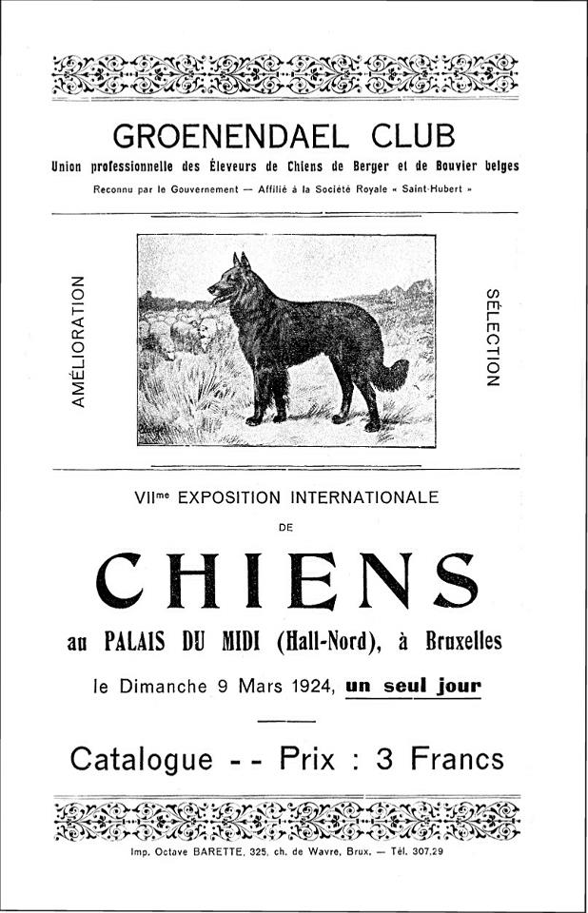
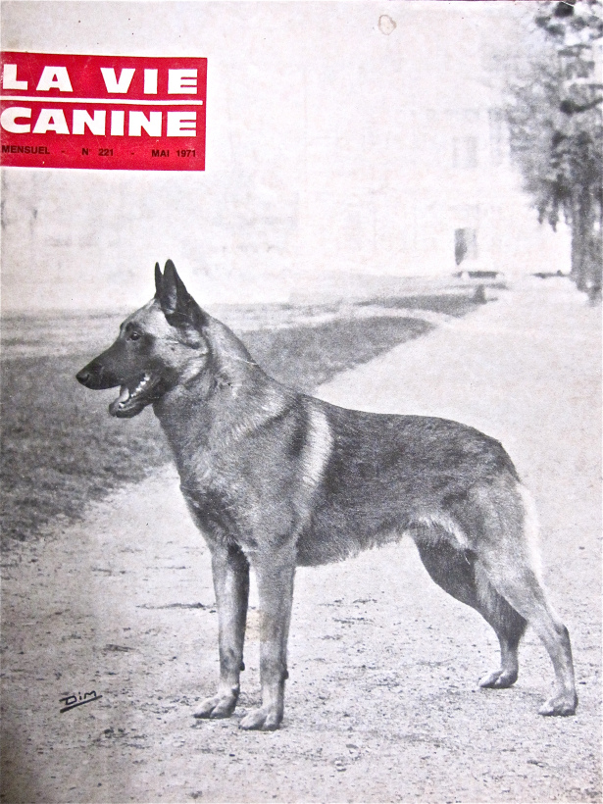

Slide 7
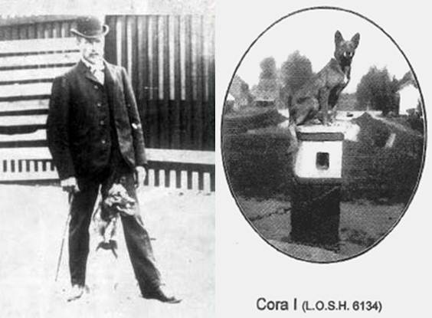

Slide 9
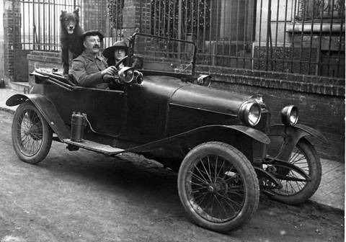
Arriving in America
The first Belgian Sheepdogs arrived in the United States in 1908
They were shown along with other shepherd breeds as Continental Shepherds
Both World Wars almost wiped out the Belgians
Notes:
Because of the effect that the wars had both here and abroad, there are no existing lines of any Belgians in the US whose lines go back to dogs that were in this country before World War II.

Slide 10
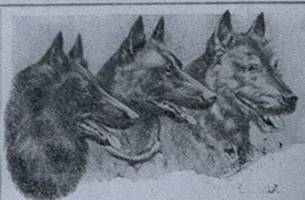
History
All Belgians were registered as one breed with the American Kennel Club until 1959 when the breed was split into three.
Good breed type has not changed over the years – this illustration is from a 1928 Belgian pedigree.
Notes:
This split occurred because of some complaints to AKC about inter-variety breeding and color issues. The black dogs took on the original name of Belgian Sheepdog. Today each AKC breed standard still describes the same essential type of dog as the ideal, with coat being the major difference in desired qualities. Aside from coat, the significant differences between the AKC standards are the emphasis that each parent club chose to place on faults

Slide 11
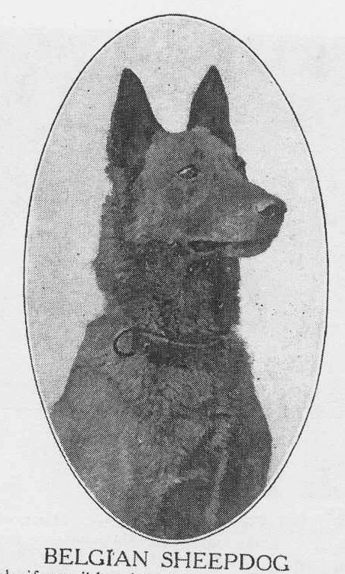
History
This photo is from the 1912 book “Dogs of All Nations” – where it describes the breed as a “very intelligent and rustic dog built to withstand the changeable climate of Belgium. His sagacity, activity, and enduring strength and dauntless courage fit him as a protector for his Belgian master.”
Notes:
It also gives the color as reddish-black with a black muzzle, height 21”, weight 54 lbs. The head is long, the skull flat, not too broad, with moderate stop. The eyes are brown, with an inquiring intelligent expression. The ears are stiff and carried erect, triangular in shape, chest broad and not too deep, back straight, strong, and of medium length. The tail is carried low in repose and should never be curled over the back, and is never docked.There are three varieties as to coat.” Good type has not changed.

Slide 12
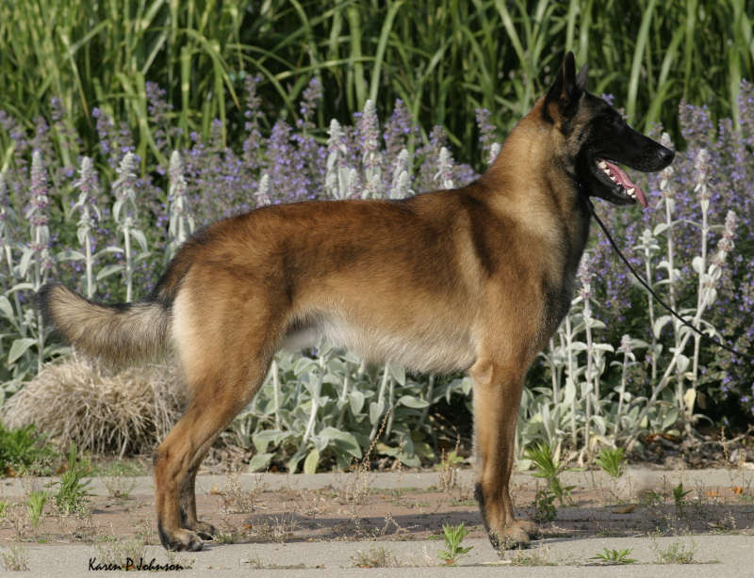
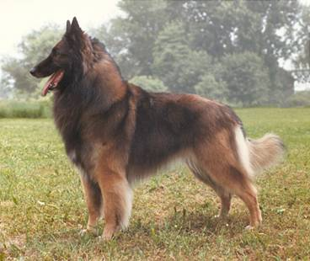
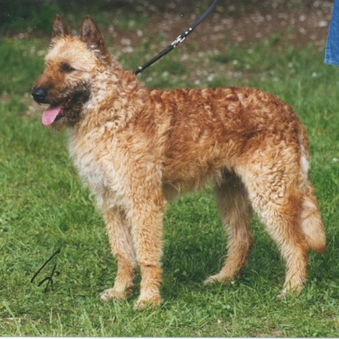
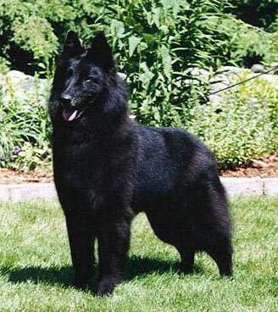
Development of the Breed
Specific development of each of the coat types of Belgians occurred in different areas surrounding Brussels
Notes:
The Belgians were developed in Belgium as one breed with different coat types and colors
Specific development of each of the coat types occurred in different areas surrounding Brussels.
The well known and recognized Berger Belge dog of the Belgian farmer was the basis for each breeders lines. Breeders in each area focused on fixing coat types and color characteristics, all the while valuing the dogs common structure, agility and trainability.
Mention if judging in Canada the breeds name has changed to the Belgian Shepherd Dog and all 4 breeds are shown together..

Slide 13
Development & Distinction
Coat type & color distinguish the four:
Malinois - short coat, fawn to mahogany
Tervuren - long coat, similar in color to the Malinois
Belgian Sheepdog - long coat, black
Laekenois – wire coat, similar in color to the Malinois
1965 moved from miscellaneous to working group
1983 all were moved to the herding group
Popularity rose dramatically in the mid ‘80s
Recent popularity increase is a concern to the parent club
Notes:
CHECK NOTES HERE! In the late 1950s the Black long haired dogs were granted breed recognition – the other coat types were told to form their own clubs – the Tervuren club did in 1960. The Malinois numbers were too low and they stayed in the miscellaneous class.

Slide 14
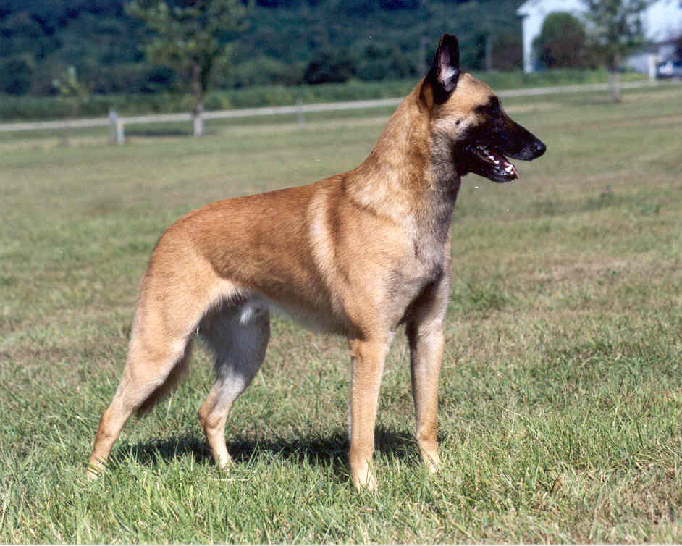
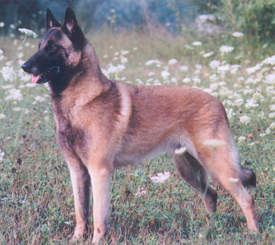
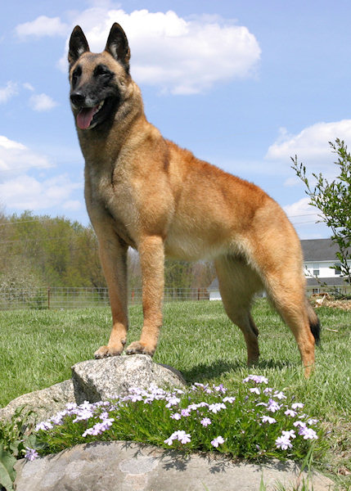
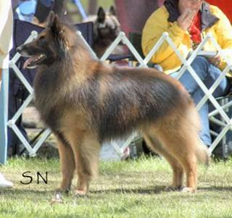
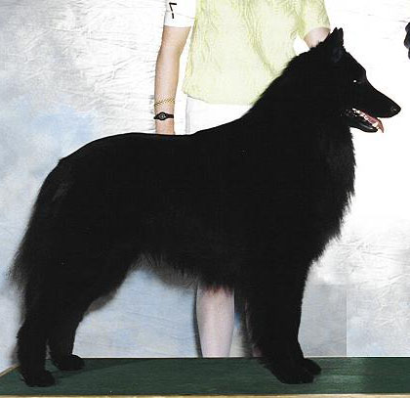
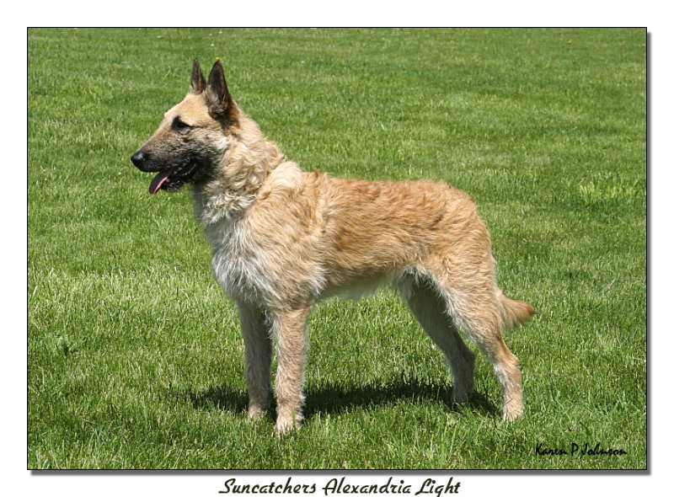
The Elegant Belgians
Notes:
The Belgians shown here all give a beautiful picture of what your first impression should be. Robust elegance.
The Belgian Malinois is a natural dog of moderate proportions demonstrating a harmonious blend of strength and elegance. He bears a close resemblance to the ancestors of all dogs and he demonstrates a strong degree of atavism. Correct Belgian Malinois breed type is often described best by its contrast between two extremes.
In the Blueprint of the Belgian Shepherd Dog, Dr. R. Pollet writes, "Strength and elegance are aspects which we must not consider as incompatible and which should go together in a most balanced way. Belgian Shepherds that are coarse, strong-limbed, or heavy are not typical. Yet the strength and robustness must be present, although Belgian Shepherds with a light skeleton ... are also not typical of the breed." Judges must be diligent in crediting the dog which demonstrates a balance between the two extremes.

Slide 15
Belgian Sheepdog - Groenendael “Groan-en-dahl”
Nicholas Rose owned a famous hotel called “Chateau de Groenendael”, 10 km south of Brussels
Mr. Rose began a breeding program that established a distinct line of long haired black sheepdogs.
From the village of Groenendael.
Notes:
A gentleman named Nicolas Rose owned a famous hotel called "Chateau de Groenendael", 10 km south of Brussels.
He began a breeding program that established a distinct line of long haired black sheepdogs.
Background:
In 1890, he owned several long haired Belgian herders and his female "Petite" won first prize among the long hair black shepherds at the big exhibition in Cureghem.
Then he purchased a beautiful male named "Picard d'uccle", and began a breeding program that firmly established a distinct line of long haired black sheepdogs. Dogs that resembled his beautiful male Duc soon came to be called the "Groenendael" Belgians.

Slide 16
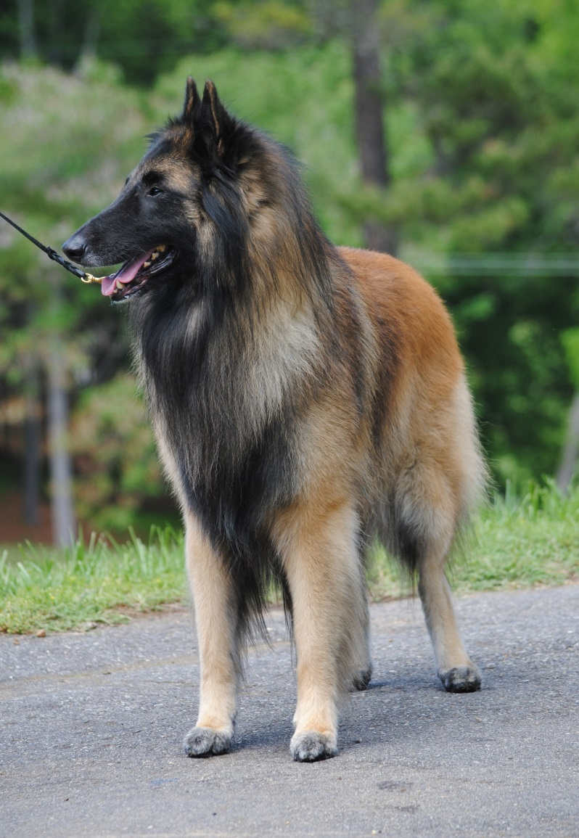
Belgian Tervuren “Ter-Vuer-en”
The Tervuren name is from the town of Tervuren, where a brewer established an early line of the fawn colored Belgian herders.
Both World Wars almost wiped out the Belgians, particularly the Tervuren. With a handful of loyal supporters, the Tervuren was born anew after the wars from the lines of other Belgians.
Notes:
The Tervuren got its name from the town of Tervuren, where a brewer established an early line of the fawn colored Belgian herders.
Both World Wars almost wiped out the Belgians, particularly the Tervuren. With a handful of loyal supporters, the Tervuren was born anew after the wars from the lines of the other Belgians.
The Tervuren
"Ter-Veur-en"
Background:
The Belgian sheepdogs were so prized for their keen desire to work, as messenger dogs, guardians and police dogs, not to mention herders, it is said that during the Wars many were taken by invaders and used on their own stock back at home. Many were also sold, some were stolen and some were undoubtedly shot during these difficult times. Since Tervuren coloration was commonly produced from Groenendael and as the longcoated offspring of Malinois, the Tervuren owes its rebirth to those varieties.
Tervuren today continue their evolution outside the US where they are produced from the lines of Groenendael and Malinois as well as Tervuren.

Slide 17
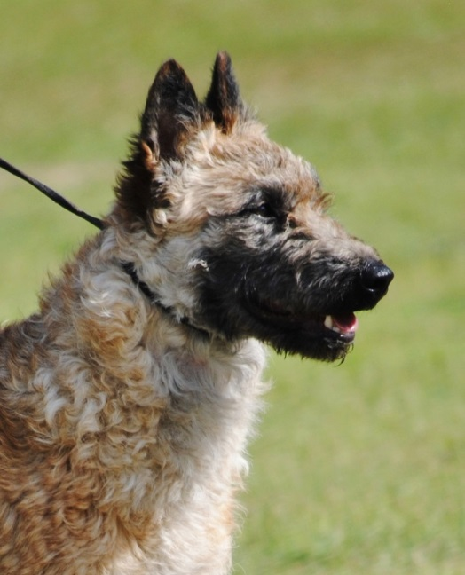
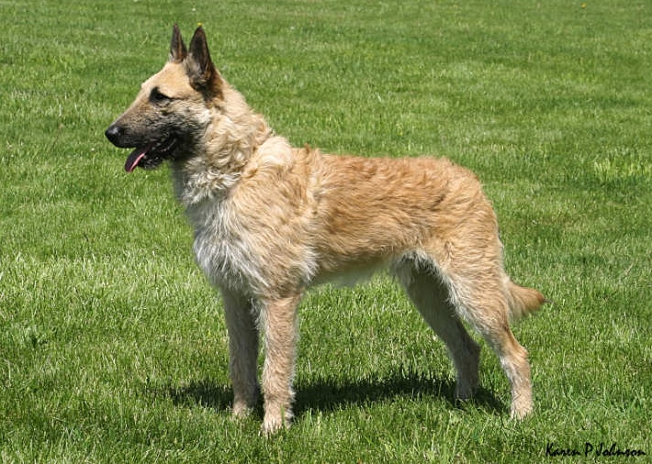
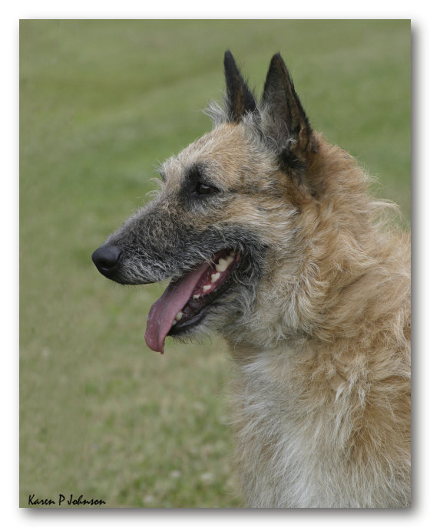
Belgian Laekenois “Lack-en-wah”
The Belgian Laekenois has a small but growing fancy in the US. Laekenois are now a recognized AKC breed.
Malinois have been vital to it’s survival.
Notes:
A shepherd named Janssens owned a male "Vos" and a female "Poes" who are considered to be the the founders for the Laeken.
The dogs seen in the early pedigrees of the Laekenois are the same dogs seen in early Bouvier pedigrees. Later, the Laeken was mated with the Malinois to fix a more uniform type, and became a variety of the Berger Belge, while the Bouvier went in another direction.
The Laeken has a small but growing fancy in the United States. Laeken are not recognized by AKC, but the parent club in the United States is working toward obtaining acceptance for regular AKC status.
Background:
In earlier times, dogs of this type were sometimes known as the "Bleekhoven biters". These were the dogs that lived in the area of homes where the linens were laid out at night to bleach. These early rough hairy shepherds were well known in the area for their guarding abilities, and people were wise to stay away from those linens!
The Malinois, played a critical role in the development of both the Tervuren and the Laekenois. The Malinois continues to remain an important link to the continued survival and improvement of the Lakenois.

Slide 18
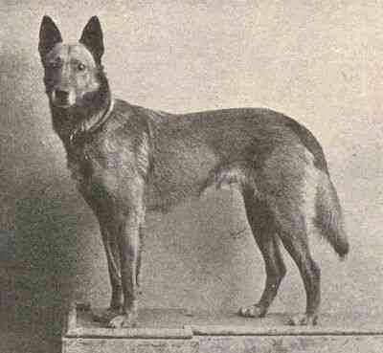
Belgian Malinois “Mal-in-Wah”
The short haired Malinois is named for the Malines (Mechlin) region.
A Laekenois ‘VOS I’ was the great grandsire of TJOP, most influential in the first part of the 20th century.
TJOP
Notes:
Each of the Belgian coat types was originally named for the region around Brussels where it was seriously developed.
The short haired Malinois is named for the Maline region.
The Laekenois ‘VOS I’ was the great grandsire of TJOP, most influential in the first part of the century.
History tells us that the first competition held for trained guard and defense dogs in the world was organized by the Malinois supporters.
Among the members of the Club of Malines, was Frantz Huyghebaert (brother of Louis), owner of TJOP (LOSH 6132), one of the pillars of the Malinois together with DEWET, who belonged to the brothers Mairesse of Frameries. The characteristics of these two champions are found in every pedigree of the first generations of selected Malinois.
TJOP was born on the 1st of November 1899 and had as father TOMY, an extraordinary guard dog (born on the 5th of October 1896) owned by H. Segers of Brussels. His mother was CORA I (LOSH 6143) (also called CORA VAN OPTEWEL) owned by Louis Opdebeeck of Malines, a laundry man by profession and an excellent trainer. CORA I won the first price of the first dressage trial of 12th and 13th of July 1903.
TJOP, who was gifted with an excellent morphology, a perfect skeleton and angulation, a good colour, but without mask, was a very good utility dog, even if it was extremely nervous. It was 57 cm. high. From its father TOMY, it had a typical head, excellent ears and a well carried tail. Even if it had the look and the intelligence of its mother, it inherited too long a back, rather too fine paws and rough hair on the croup.
VOS (LOSH 5647) (called also VOS DES POLDERS), born in 1897 and owned by Mrs J. Van Haesendonck of Antwerp, was the father of DEWET (LOSH 6466) and MOUCHE (owned by Mrs Duchenoy) was his mother.
This was how Henri van Aldaba de Haan Hettema expressed himself about DEWET (60 cm. high), when he was judge for the dog show in Brussels in 1902 : “It is a magnificent dog, very well built, with an excellent coat and highly recommended, remarkable shoulders and chest, back and croup out of the line, good head, faultless carrying of the tail, small triangular ears, excellent general effect. But, since there is always a but, the colour is rather pale. This fault however is largely compensated by the black mask and the strong shade on the shoulders.”
All the efforts of the fanciers led, around 1900, to the production of these two beautiful dogs - who are quite different from one another - between whom a battle was fought and whose names we can find in almost every actual pedigree; one might even say that studying the line of TJOP and DEWET, is like studying the principal ancestors of the variety.
Jean-Marie Vanbutsele (translated by Pascale)

Slide 19
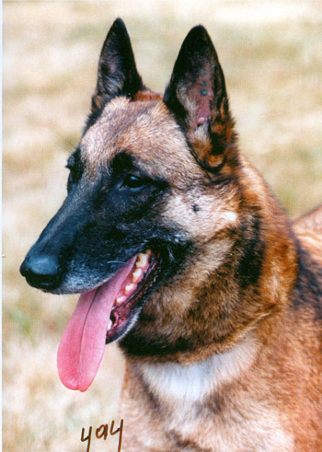
Malinois Type What Defines it ?
Silhouette – Square, elegant
Structure – Moderate, power without bulkiness
Head - Clean, chiseled, parallel planes, balanced
Expression – Intelligent, alert, ready for action
Coat/Color – Medium-harsh, warm hues, masking
Movement - Effortless, agile, efficient, moderate
Temperament – confident, watchful, stable, biddable
Notes:
We will talk about these bullets in much greater depth. Together they will create in your mind a picture of strength and capability with elegance.

Slide 20
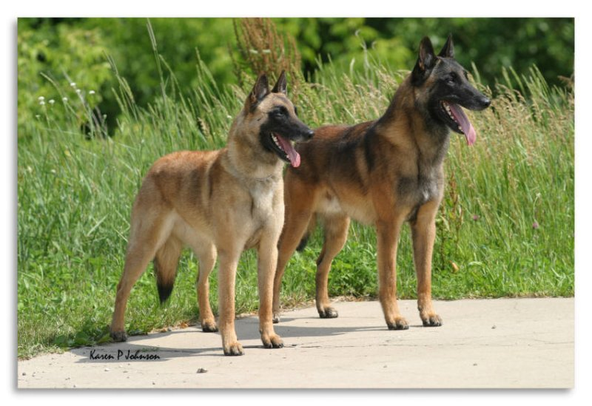
Malinois Type… What Defines it ?
“The Belgian Malinois is a well-balanced square dog, elegant in appearance with an exceedingly proud carriage of head and neck. The dog is strong, agile, well-muscled, alert, and full of life. He is hardy and built to withstand the rugged Belgian climate. His elegance and expression denote great strength of character reflecting his heritage as a herding breed.”
Notes:
“The male should appear unquestionably masculine; the female should have a distinctly feminine look and be judged equally with the male.”

Slide 21
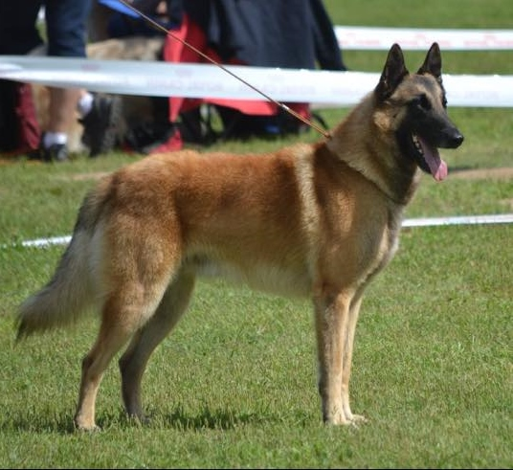
Malinois Type….What Defines it ?
Silhouette: “He stands squarely on all fours and viewed from the side, the topline, forelegs, and hind legs closely approximate a square. The whole conformation gives the impression of depth and solidity without bulkiness.”
Notes:
A Belgian Malinois should be recognizable from a distance by its silhouette alone. This is what many judges look at when the dogs are first set up in the ring – that silhouette , which should be square with proud carriage of head. SQUARE is a defining characteristic of our breed. If you look at a dog and are not certain that it is a Belgian Malinois, it’s not likely that it is a good representation of the breed. This is where a judge may choose to withhold a ribbon for “lack of merit”.

Slide 22
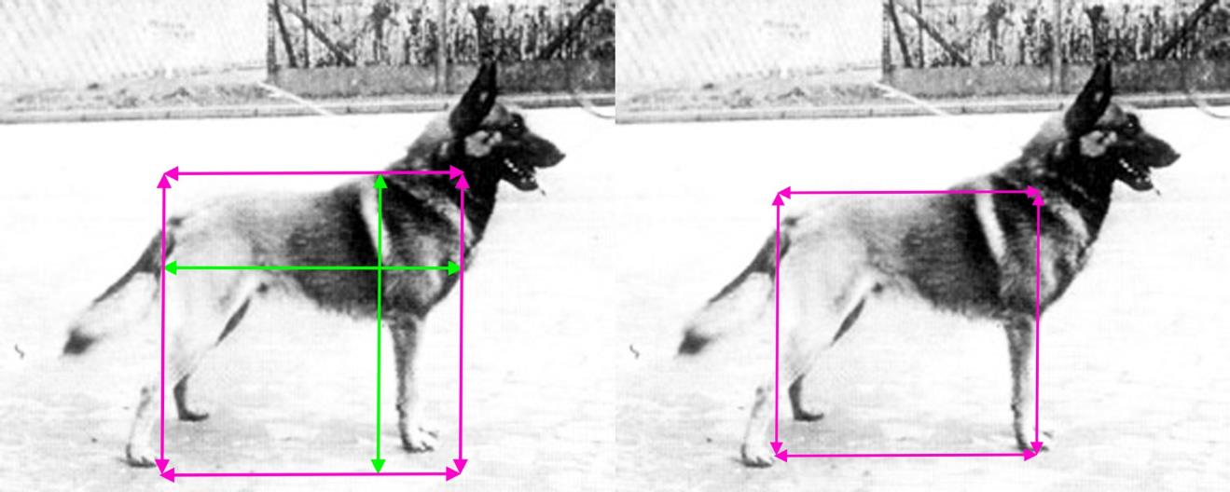
Square – chest to rump approximates withers to ground, with length of leg equal to depth of chest
Proud carriage – head is held high, showing interest, alertness, confidence
Withers are pronounced, the back is firm
Croup is very slightly sloped
Moderate bone in proportion to height
Notes:
Belgians are a SQUARE breed. The length measured from the point of breastbone to the point of rump, should equal the height. When viewing the silhouette, the topline, front legs and back legs should closely approximate a square.
Bone structure is moderate in proportion to the height so that the dog is well balanced throughout and neither spindly or leggy nor cumbersome and bulky.

Slide 23
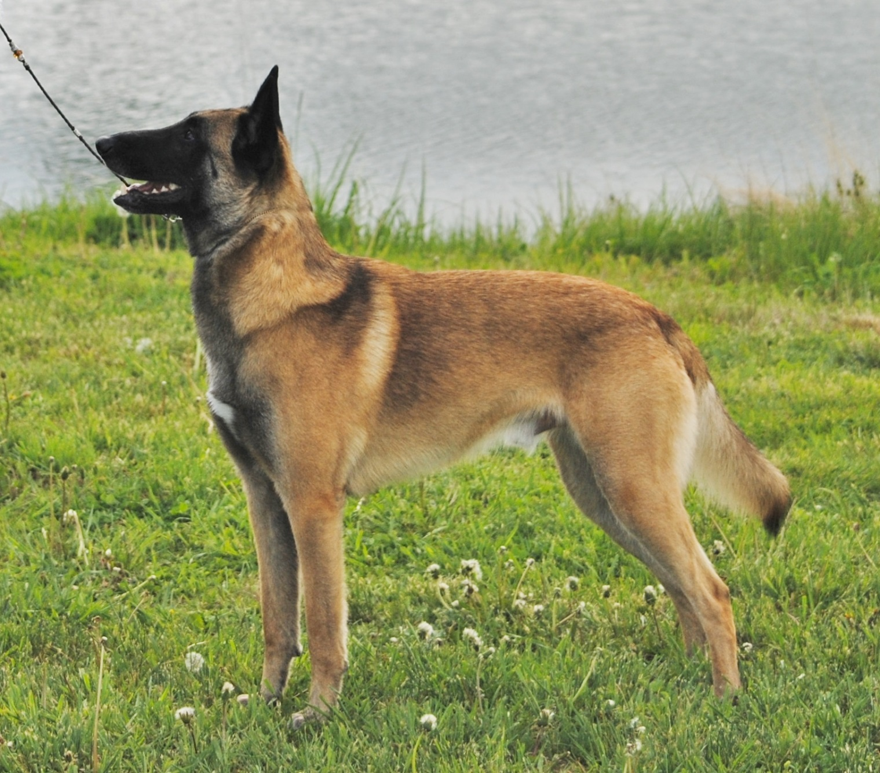

Slide 24
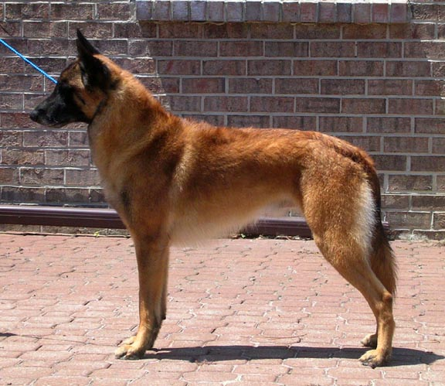
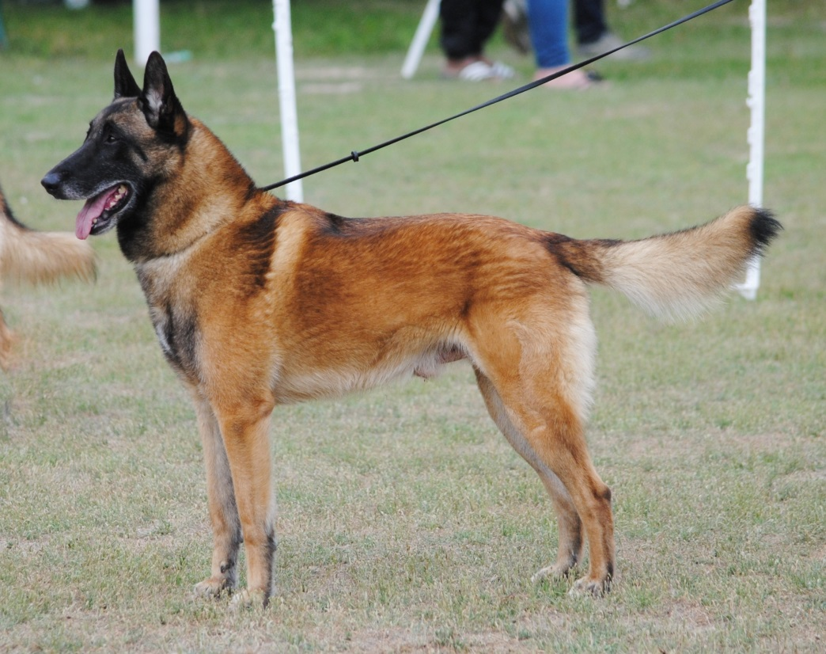
Silhouette

Slide 25
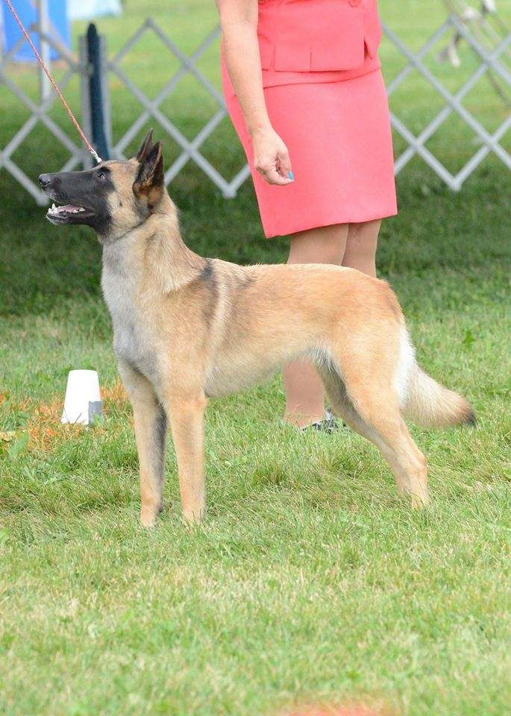
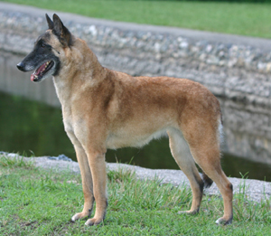
Silhouette

Slide 26
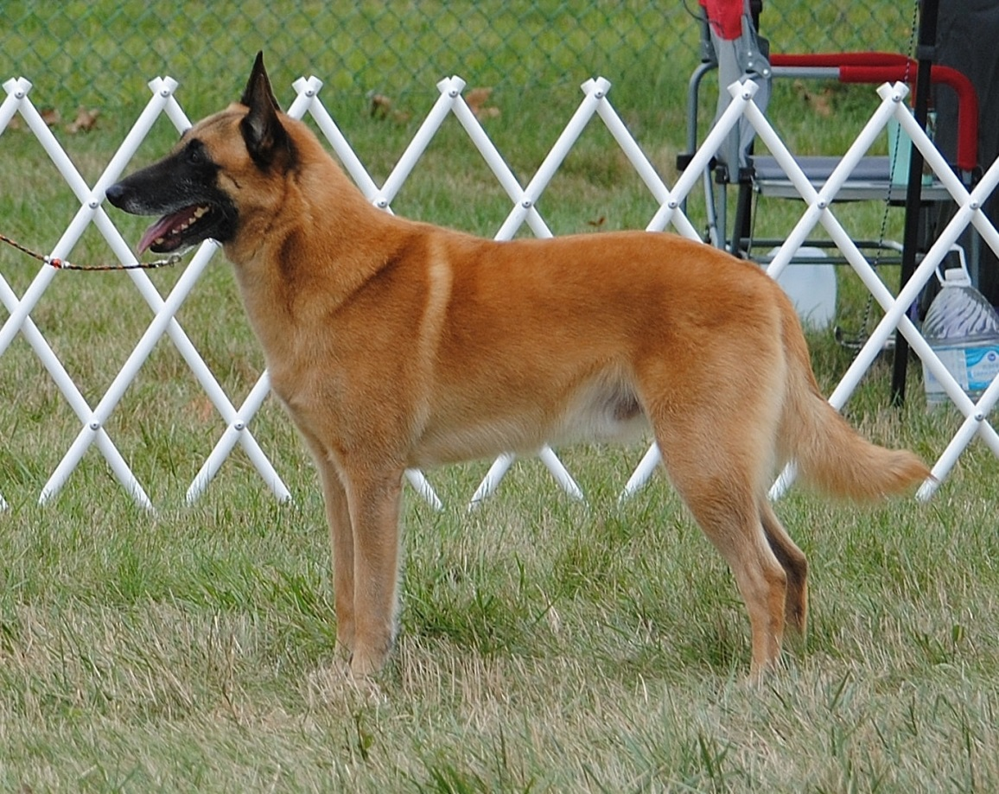
Topline
“The withers are pronounced, and the back is firm. The loin is solid, short, and sufficiently well-muscled.
The croup is very slightly sloped..”
Notes:
While this does show a correct topline and underline, this dog is overstretched. Common topline faults: lack of height at withers, high rear, steep croup.

Slide 27
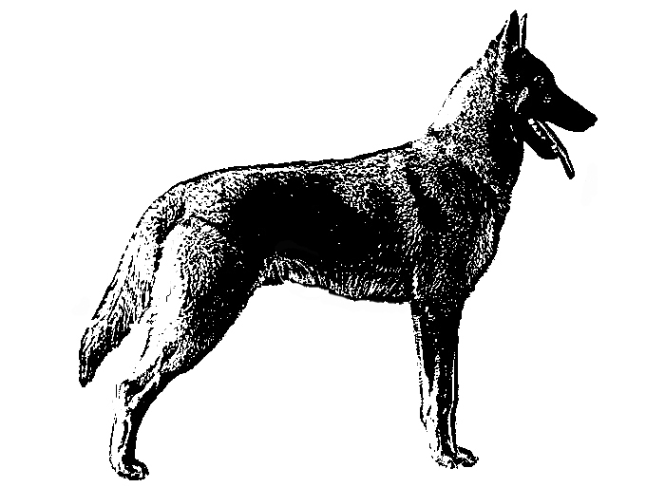
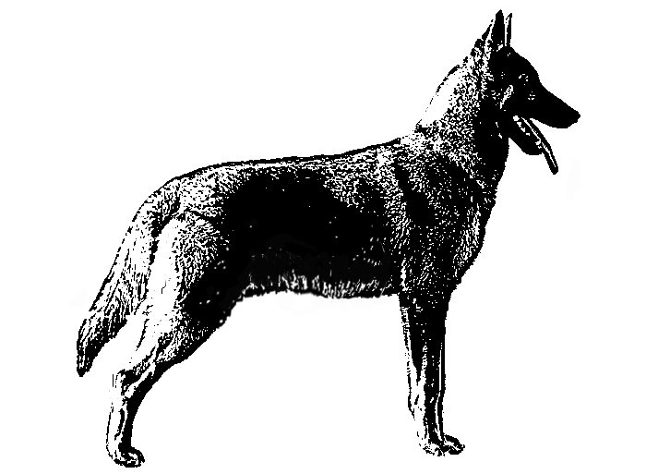
Underline
Correct Underline Too Much Paunch
“The underline rises gently in a harmonious curve toward the abdomen, which is neither tucked-up nor paunchy.”
Notes:
Common faults: Insufficient depth of chest, barrel chest in some coarse atypical specimens, too much tuck-up (whippet –like).

Slide 28
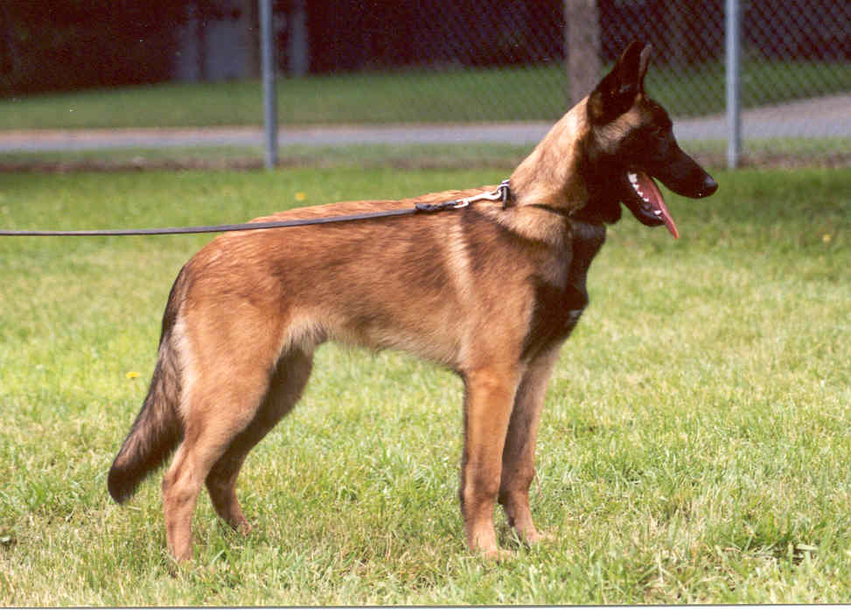
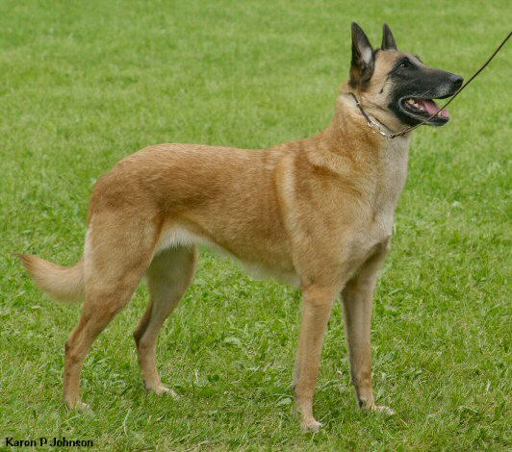
Tails
“The tail is strong at the base, reaching to the hock, and carried down at rest. It is curved, raised when moving, but not passing the horizontal or forming a hook or deviation.”
Notes:
We do want judges to check tail length – “A cropped or stump tail is a disqualification”. When the Belgian Shepherd Dog was first emerging as a distinct breed, some individuals who were used had natural bob tails. A complete tail became a requirement around 1898 and although uncommon, the genetics still exist for a shortened tail. A genetic prelude to a natural bob may be a crooked or “divergent” tail. Carried down or parallel to ground when standing. When moving carried in an “alert” curved position, without forming a hook. Should not be gay or curled over back. Bone reaching to the hock. A cropped or stumped tail is a DQ.

Slide 29
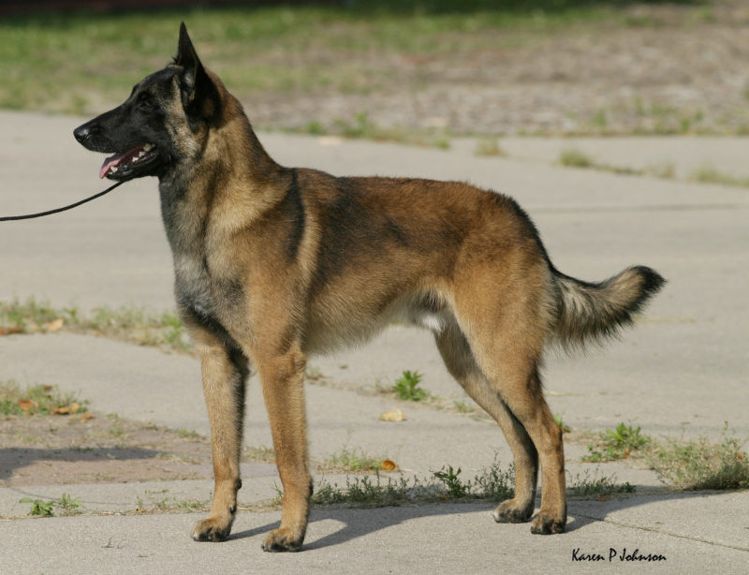
Malinois Type….What Defines it ?
Structure: “Bone structure is moderate in proportion
to the height so that the dog is well balanced
throughout and neither spindly or leggy nor
cumbersome and bulky.
Notes:
Correct size is an important consideration when judging the Belgian Malinois if the Belgian Malinois is to be maintained as a moderate dog. There is considerable size variation within our present gene pool. There is a tendency when judging to forgive a larger dog and penalize a smaller individual. This may lead to acceptance of an atypical Belgian Malinois and divergence from the standard’s description of a medium-sized, moderate dog. This tendency is compounded by the fact that the Belgian Malinois, with his shorter coat, appears shorter than the longhaired Tervuren or Belgian Sheepdog of the same height. The longer hair gives the illusion of more size.

Slide 30
Size, Proportion & Substance
Males - 24 to 26 inches
Females - 22 to 24 inches
“Length, measured from point of breastbone to point of rump, should equal the height”
Bone structure is moderate in proportion to height so the dog is well-balanced throughout – neither spindly or leggy nor cumbersome and bulky”
“The male should appear unquestionably masculine; the female should have a distinctly feminine look and be judged equally with the male.
Notes:
In the standard change of 2021 - The Belgian Malinois is a moderate breed, so the word Heavy was removed. The Belgian Malinois is a square breed, so the reference allowing bitches to be longer was removed.

Slide 31
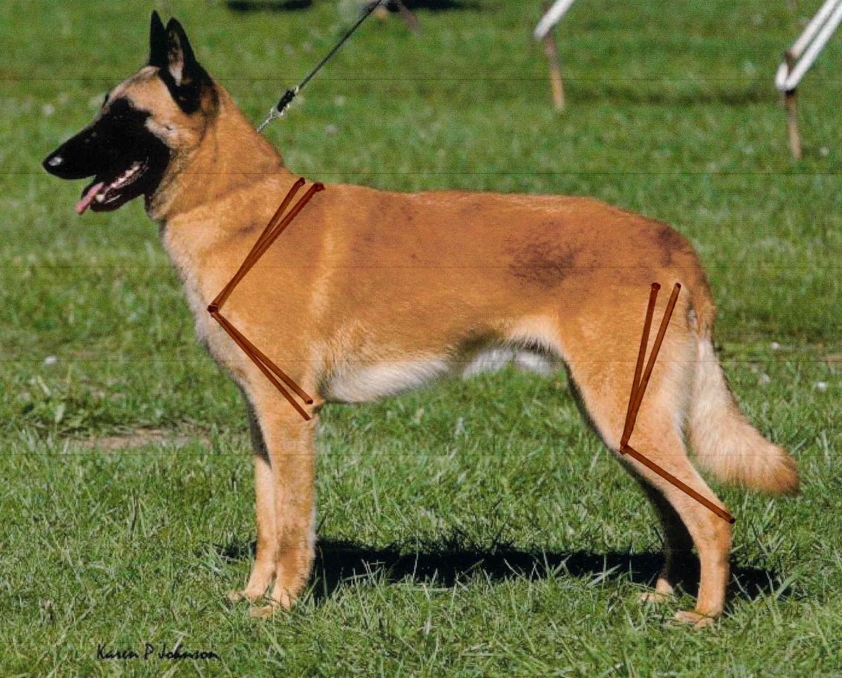
Angulation
Notes:
Long and sloping
Flat against the body
Sufficient angle with the upper arm to ensure free & easy movement
Muscular without bulkiness

Slide 32
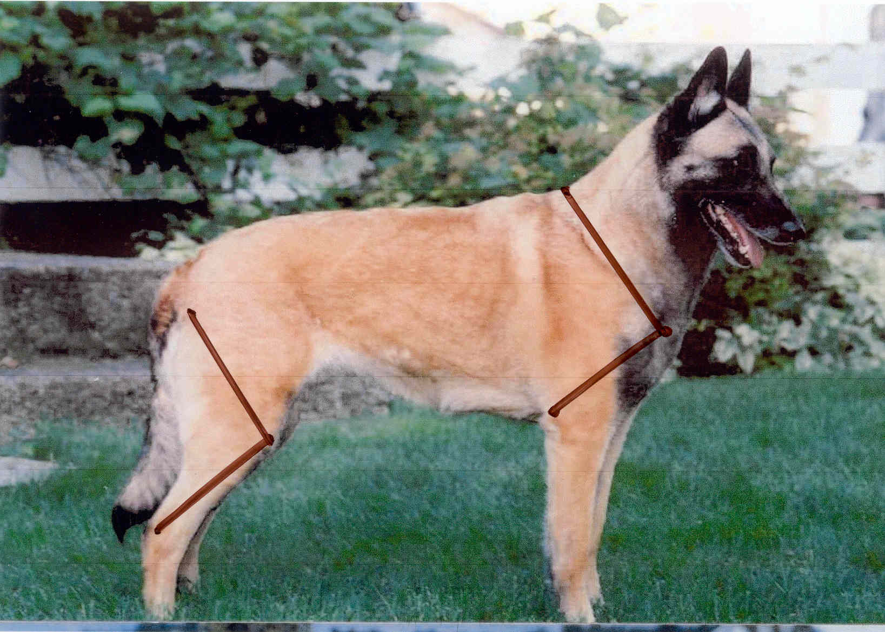
Angulation

Slide 33
Forequarters
“Muscular without excessive bulkiness”
“Shoulder blades are long and sloping laid flat against the body, forming a sufficient angle with the upper arm to ensure free and efficient movement”
“Legs straight, strong & parallel”
“Bone is solid but not heavy, more oval than round”
“Pasterns are short, strong, very slightly sloped”
“Feet are cat-like, well padded, toes curved close together”
Nails are strong & black, except they may be white to match the white toe tips

Slide 34
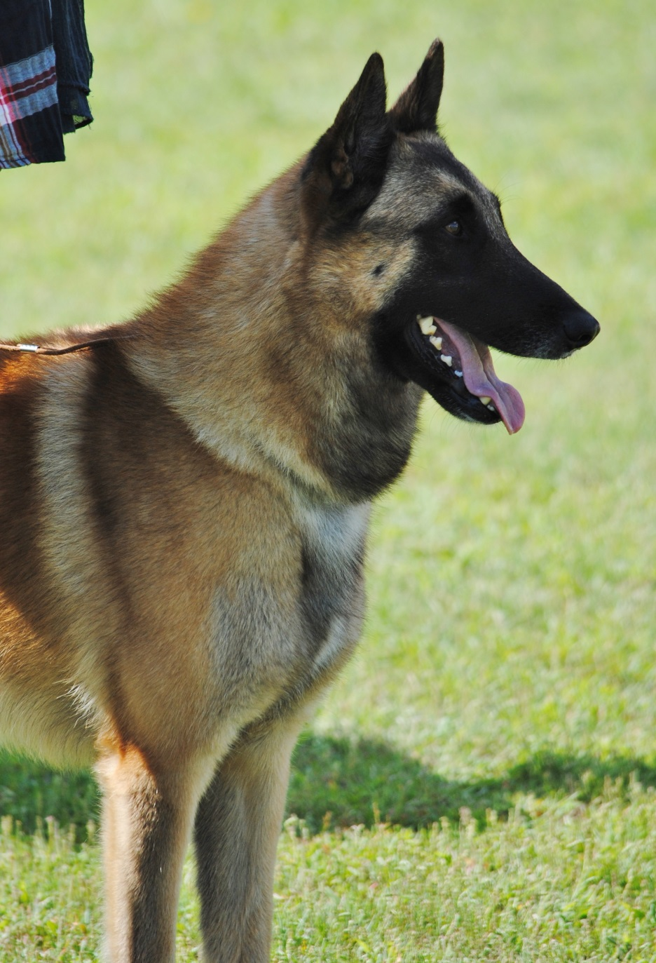
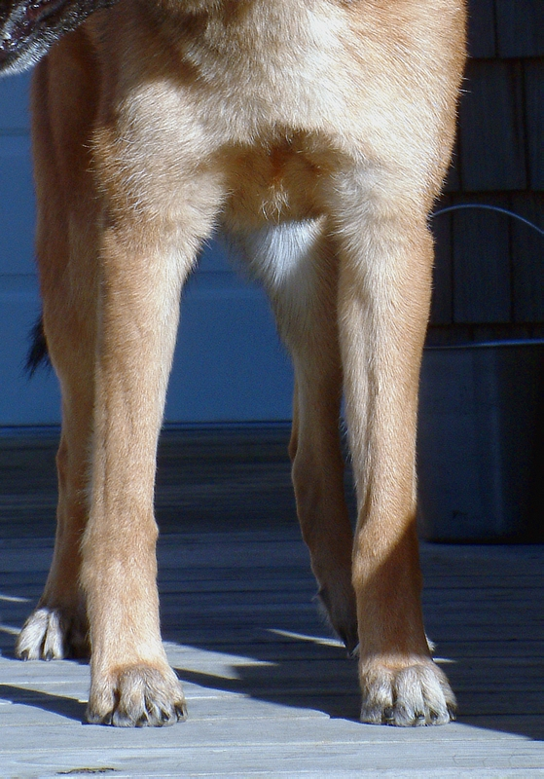
Forequarters
Notes:
Deep not broad
Lowest point reaches the elbow
Forechest apparent to the extent that it is not hidden inside the shoulders
Withers to chest = elbow to ground

Slide 35
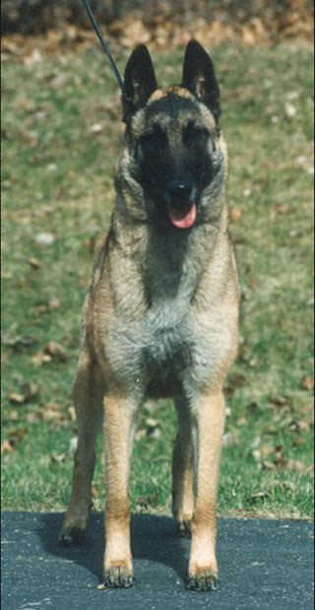
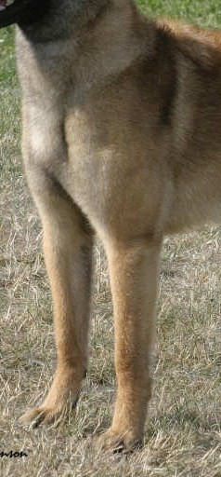

Slide 36
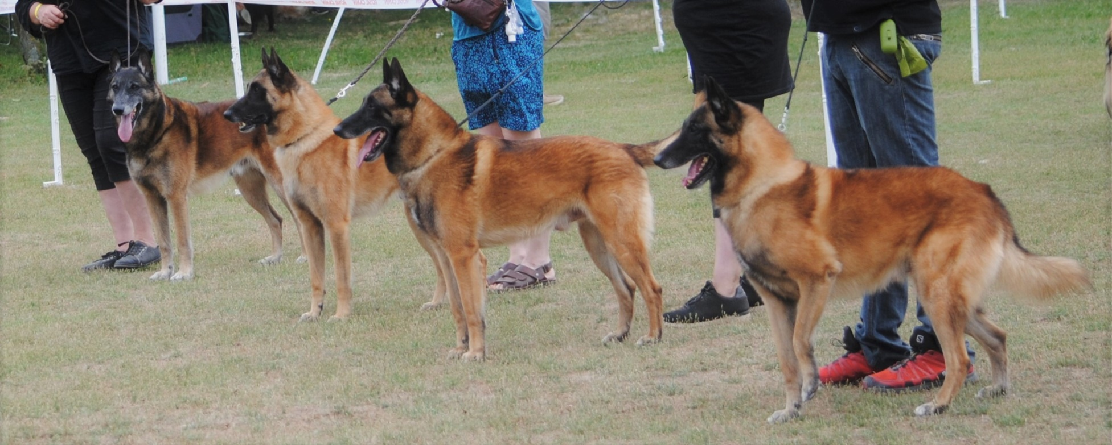

Slide 37
Hindquarters
“In balance with the forequarters”
“Upper and lower thigh bones should approximately parallel the shoulder blade and upper arm”
“Legs parallel, thighs well-muscled”
“Hocks are short, strong, parallel and moderately angulated”
“Metatarsi are strong & short”
“Dewclaws may be removed”
“Hind feet are oval”
Notes:
The hind feet are slightly oval, toes are arched and compact. Pads are thick and well padded. Nails are dark and strong, although they may be white to match white toes.

Slide 38
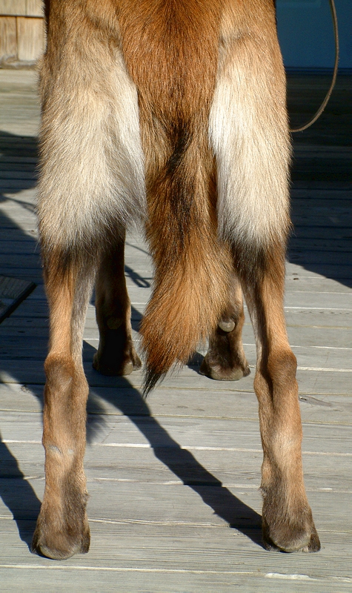
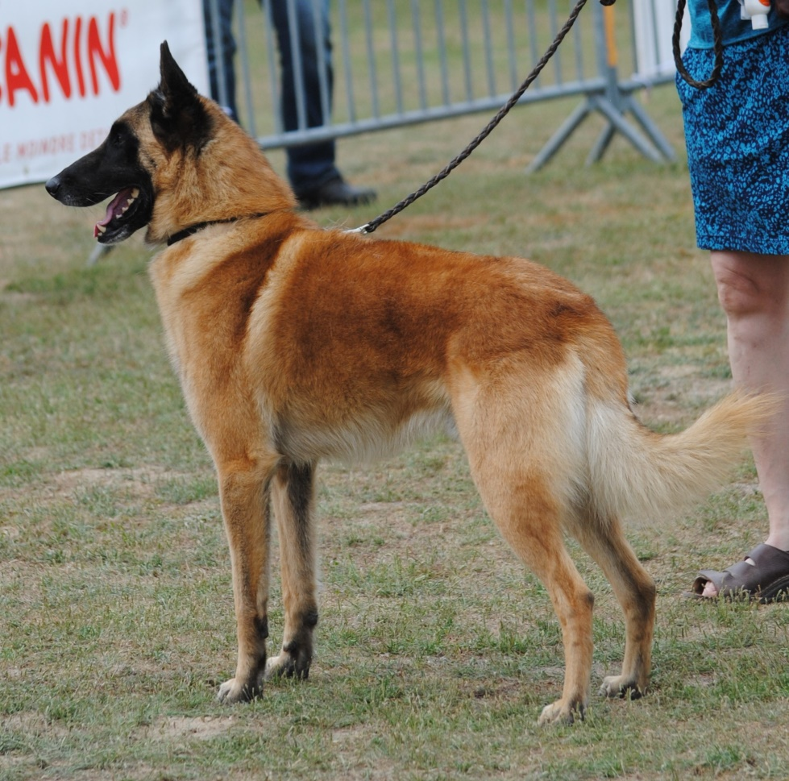
Hindquarters
Notes:
Replace right photo - feet under hips

Slide 41
Feet
Notes:
Feet photo!

Slide 42
Young Malinois

Slide 43
Adolescents

Slide 44
Notes:
6 - 9 Mos - Black is darker, Red often becomes more vivid with age, Immature, silly, playful, may not hold a stand, May be overly aware
1 - 3 Yrs - Good movement should remain good, Appearance of ranginess, slab sidedness often disappears by 4 years, Heads can change a lot, for better or worse

Slide 45
Malinois Type….What Defines it?
Head: “The head is carried high. It is long without exaggeration, rectilinear, well-chiseled and dry.”
This is what unmistakably identifies the dog as a Belgian.

Slide 46
Head
Eyes are brown, preferably dark brown, slightly almond shaped.
Ears are small, high-set and triangular.
Top skull is flattened rather than rounded
Top Skull & Muzzle roughly equal in length, slight bias to the muzzle
Stop is moderate.
Muzzle well-chiseled under the eyes, narrowing like a wedge
Planes of the muzzle and topskull are parallel.
Mouth is well-split
Lips are thin, tight and strongly pigmented black
Notes:
We will cover each area as we progress.
Some common head faults include rounded topskull, coarse or heavy head, round and/or light colored eyes

Slide 47
Chiseling Zygomatic arch is kept tight to the head and does not bow out. Cheeks are flat and clean.
Notes:
The zygomatic arch plays a huge role in the clean wedge. Note the chiseling under the eyes and the underline of the jaw and muzzle. Elegant wedge, not blocky. The head feels flat, not curved or rounded.

Slide 48
Eyes “The eyes radiate attentiveness and readiness for action. The eyes are of medium size, neither protruding nor sunken, slightly almond shaped, and obliquely set. They are brown, preferably dark brown with black rimmed upper and lower eyelids. Light eyes are a fault.”

Slide 49
Eyes “The gaze is intelligent and questioning”
Notes:
The eyes are of medium size, neither protruding nor sunken, slightly almond shaped, and obliquely set.
They are brown, preferably dark brown with black rimmed upper and lower eyelids.
Light eyes are a fault.

Slide 50
Eye Faults

Slide 51
Ears
“The ears are rather small, set high and distinctly triangular with a well-cupped outer ear and pointed tips.
They should be stiff and carried upright and vertical when the dog is alert.
Ears hanging as on a hound or semi-prick are a DQ.”
Notes:
Ears appear shorter in the Tervuren and Sheepdog due to hair length, pointed to slightly round, black in color,
Correct ear size and set are an area of work for many breeders – common ear faults are too tall, too wide, too rounded, divergent set.

Slide 52
Good Ears

Slide 53
Ear Faults

Slide 54
Skull & Muzzle
“Skull and muzzle are roughly equal in length, with at the most a very slight bias in favor of the muzzle.
The top skull is of medium width, in proportion with the length of the head, with a forehead flat rather than round, frontal groove not
very pronounced; “

Slide 55
Skull & Muzzle

Slide 56
Head Planes
“in profile, the head planes are
parallel; occipital crest, brow ridges and zygomatic arches not prominent.”

Slide 57
Parallel Planes
Notes:
The look of the topskull can change when the dog’s ears are up.

Slide 58
Moderate Stop
“The stop is moderate.”
Notes:
Examples of “Moderate stop” in the Malinois

Slide 59
Too Much Stop

Slide 60
“The nose is black.
The muzzle is of medium
length and well chiseled under the eyes;
narrowing gradually toward the nose, like an
elongated wedge.”
Notes:
Viewed from the front you should see a wedge shape. Not wide but with a slight flare from front to back.
A one piece look – without a prominent outward bulge at the cheek area.

Slide 61
“The mouth is well split, which means that when the mouth is open the commissures of the lips are pulled right back, the jaws being well apart. The lips are thin, tight and strongly pigmented black”
Notes:
A “well-split” mouth is often referenced with Belgians. This photo show that the lips are tight and the teeth are easily viewed when the mouth is open.

Slide 62
Coarseness / Lack of Elegance
Head appears heavy
Ears too large or wide set
Eyes too round or light
Lack of chiseling under the eyes
Heavy jowls
“Bully” look
Domed topskull
Notes:
Untypical Malinois – a lack of elegance
Faults you may encounter

Slide 63
Dentition
“The Belgian Malinois has a full complement of strong white teeth that are evenly set and meet in a scissors or level bite. Overshot or undershot bites are a fault. An undershot bite in which two or more of the upper incisors lose contact with two or more of the lower incisors is a disqualification. Complete dentition is preferred. Missing teeth should be faulted.”
Notes:
Dentition: Common faults include undershot bites and missing teeth.

Slide 64
While the standard calls for a “full complement of strong white teeth” it is not necessary to open the entire mouth
Having the handler gently lift the lips will allow you to see side dentition

Slide 65
Lifting the sides of the mouth to examine our bites will allow you to check for full dentition.
If teeth are missing, it is usually the premolars.
Please DO NOT pry open the mouth.

Slide 66
Malinois Type...What Defines it ?
Expression – The sum of the features of the head. Intelligent, questioning, alert, ready-for-action
Notes:
We need the ears to be up to signal “alert”, intelligence is most often attributed to the eyes. The expression should be kind as opposed to harsh.

Slide 67
Head & Expression Dog & Bitch

Slide 68
Feminine Females

Slide 69
Masculine Males

Slide 70
Elegance is Ageless

Slide 71
Vibrant Veterans

Slide 72
Malinois Type….What Defines it ?
Coat - “the coat should be comparatively short, straight, hard enough to be weather resistant, with dense undercoat.”
Notes:
“The coat should be very short on the head, ears, and lower legs. The hair is somewhat longer around the neck where it forms a collarette, and on the tail and backs of the thighs. There is considerable variation in the coat length of the Belgian Malinois. There is no one length of coat which is most correct. Coats which deviate from the standard include an extremely short coat with absence of undercoat as might be correct on a Great Dane or Boxer – or a coat with distinct feathering on the backs of the forelegs. A wavy coat would be faulted.
The Belgian Malinois is a natural breed and there is no need for excessive grooming.

Slide 73
Notes:
Short & Straight, Hard enough to be weather resistant, Undercoat dense
Very short on head, ears and lower legs, Somewhat longer around the neck, tail and back of thighs
The coat should conform to the body without standing out or hanging down. Lack of sufficient undercoat to form a double coat is a FAULT. Hair that is too long, silky or wiry is a FAULT.

Slide 75
“The Belgian Malinois is a natural breed and there is no need for excessive grooming.”

Slide 76
Color
“The ideal coloring is a rich fawn to mahogany, with black tips on the hairs giving an overlay appearance.”
Notes:
“The blackening must not appear as patched or brindled. The underparts of the body, tail
and breeches are lighter fawn. Washed out fawn color on the body is a fault.”

Slide 77
Range of Color

Slide 79
White Patches
Notes:
“The tips of the toes maybe white, and a small white spot on the breastbone/prosternum is permitted, not to extend to the neck. White markings, except as noted, are faulted.”

Slide 80
Masking
“The mask and ears appear black”
Notes:
Mask must be pronounced and tends to encompass the top and bottom lip, the corners of the lips and the eyelids in a single black zone. The mask and ears appear black. Frosting or graying of the muzzle is permitted and may appear on very young dogs.

Slide 81
Range of Masking

Slide 82
Frosting

Slide 83
Malinois Type….What Defines it ?
Movement – “The movement is smooth, free and easy,
seemly never tiring, exhibiting facility of movement rather
than a hard driving action. The Belgian Malinois single tracks at a fast gait, the legs, both front and rear, converging toward the center line of gravity, while the topline remains firm and level, parallel to the line of motion with no crabbing”
Notes:
Belgians are incredibly light on their feet. Correct gait is in accordance with the moderate angulation of the Malinois. There is a tendency to favor an extreme side gait in the American show ring, which is not correct for the breed. The Belgian Malinois is active and always on the move, seeming untiring. He moves with a supple, free and firm but never exaggerated ground-covering gait.

Slide 84
Movement

Slide 85
Movement

Slide 86
Movement

Slide 87
Movement

Slide 88
Movement

Slide 89
Movement Coming & Going

Slide 90
Faulty movement

Slide 91
Malinois Type….What Defines it ?
Temperament – “Correct temperament is essential to the working character of the Belgian Malinois. He is alert, intelligent, inquisitive, and confident, showing neither fear nor aggression.”

Slide 92
“He is energetic, ready for action, yet highly responsive to his owner’s direction. His lively character should be evident in his proud carriage and the sparkling attentive eyes.”

Slide 93
“The Belgian Malinois is an exceptional watchdog. Vigilant, yet responsive, he balances all the qualities needed in a stock dog, protector, and sensible working partner.”

Slide 94
“He is firmly loyal to those he loves but may be indifferent with strangers.”

Slide 95
Temperament – working ability starts young

Slide 96
Temperament- they love their families
Notes:
The temperament of the Belgian Malinois is epitomized by his extreme devotion to his owner. Jean Marie Vansbutsele in his book “A Hundred Years of the Belgian Shepherd Dog” , writes “The Belgian Shepherd’s behavior is characterized by a greater sensitivity than other breeds and it is hyper-affectionate” A journalist in Zurich wrote in 1983 that they were called “Weiberhunde” – which signifies that the dog shows you his attachment.

Slide 97
They excel in obedience
Notes:
The Malinois is considered a working dog in that many still work flocks and have guard duty. For many ‘would be’ owners these are not necessarily optimal traits. A herding dog with territorial instincts, they are naturally suspicious, but extremely intelligent. Active - Alert – Aware Neither shy nor aggressive but may be reserved.

Slide 98
They excel in agility

Slide 99
They excel in tracking

Slide 100
They excel in herding

Slide 101
Whatever your game
they will perform

Slide 102
Temperament - they love to PLAY
Notes:
A Malinois that is not mentally stimulated will probably acquire habits that do not endear it to their owners or families. They will find something to do.

Slide 103
They love to WORK

Slide 104
…..and WORK hard – there is a proud history of service and trainability.
Notes:
After 9/11 people became much more aware that the dogs they were seeing on the television were not all GSDs. Breeders are being swamped with calls from people wanting what is perceived to be the latest ‘macho’ dog, many of the calls are legitimately from law enforcement too. Remember their service in WW2?….that dedication continues today as many serve in police departments, search & rescue units, military operations, and homeland security.

Slide 105
That work ethic is very evident and active in today’s world. A U.S. soldier with the 10th Special Forces Group and his dog leap off the ramp of a CH-47 Chinook helicopter during water training over the Gulf of Mexico as part of exercise Emerald Warrior
Notes:
Dogs have been fighting alongside U.S. soldiers for more than 100 years, seeing combat in the Civil War and WWI. But their service was informal; only in 1942 were canines officially inducted into the U.S. Army. Today, they're a central part of U.S. efforts in Iraq and Afghanistan -- as of early 2010 the U.S. Army had 2800 active-duty dogs deployed (the largest canine contingent in the world). And these numbers will continue to grow as these dogs become an ever-more-vital military asset. So it should come as no surprise that among the 79 commandos involved in Operation Neptune Spear that resulted in Osama bin Laden's killing, there was one dog -- the elite of the four-legged variety. And though the dog in question remains an enigma -- another mysterious detail of the still-unfolding narrative of that historic mission -- there should be little reason to speculate about why there was a dog involved: Man's best friend is a pretty fearsome warrior.

Slide 106
The nose knows: A canine's olfactory powers are well known -- dogs are now even being used to sniff out rare types of cancer -- and that natural ability hasn't gone unnoticed by the U.S. military. More remarkable still are vapor-wake dogs.
Notes:
Scientists at Auburn University's College of Veterinary Medicine have genetically bred and specially trained canines to not only detect stationary bombs or bomb-making materials, but identify and alert their handler to the moving scent of explosive devices and materials left behind in the air, say, as a suicide bomber walked through a crowd -- all without ever tipping off the perpetrator. While not as expensive as some military-trained dogs, the cost of breeding and training these dogs cost is not cheap at around $20,000 each.
Above, U.S. sergeant Matthew Templet and his bomb-sniffing dog Basco search for the explosives in an abandoned house in Haji Ghaffar village during a clearance patrol in Kandahar. In October 2010, the Pentagon announced that after six years and $19 billion spent in the attempt to build the ultimate bomb detector technology, dogs were still the most accurate sniffers around. The rate of detection with the Pentagon's fanciest equipment -- drones and aerial detectors -- was a 50 percent success rate, but when a dog was involved it rose to 80 percent.

Slide 107
Fierce protectors: Military dogs and their handlers often form deep bonds -- it's an essential part of the canine-handler relationship that is specifically built into their training regimen. The personal attachments are often so intense that it can take weeks of training before a dog can begin working with a new handler.
Notes:
It's not the gear that makes the dog: Military working dogs (MWDs in Army parlance) may not enjoy all the privileges of being full-fledged soldiers, but the U.S. military no longer considers them mere equipment. (The war dogs deployed to Vietnam during that conflict were classified as "surplus equipment" and left behind.) Today, MWDs are outfitted with equipment of their own -- a range of specialized gear that includes Doggles (protective eye wear), body armor, life vests, gas masks, long-range GPS-equipped vests, and high-tech canine "flak jackets."

Slide 108
100 years later, this quote still rings true, “His sagacity, activity, and enduring strength and dauntless courage fit him as a protector for his Belgian master”.

Slide 109
Temperament and the ATTITUDE that says “I’m ready for Anything!”
Notes:
It all shows up in the silhouette!! It is part of the overall impression in the ring. In the showring the Malinois should be confident when approached. However, he is not expected to make overtures to the judge (but he may). He must be accepting of friendly strangers even though he does not necessarily solicit their attention. Malinois which shy away from the judge or resist his examination must be penalized. This fault, which may be rooted in a lack of training, poor socialization, poor bonding, or genetically poor character, presents a negative impression of the breed and such an individual should not be rewarded.

Slide 110
Judging
Most dogs are owner handled
Most are free baited and not hand stacked
Approach confidently without hesitation from the front
The dogs are very focused on the handler make sure they know you are coming
Avoid prolonged eye contact
Dogs that approach you and seem to greet you usually have great temperament
Aloof or reserved, if not fearful, should not be penalized
NEVER accept questionable temperament

Slide 112
Disqualifications
Size
Males - less that 23” or more than 27”
Females - less than 21” or more than 25”
When in doubt – please measure
Ears – hanging as on a hound or semi-prick
Undershot bite, in which two or more of the upper incisors lose contact with two or more of the lower incisors
Tail - cropped or stumped
Color – any color or color combination not described in the standard

Slide 114
Summary
Consider the overall dog
Remember the beautiful elegant Belgian type
Head – elegant
Expression - intelligent
Silhouette -square
Structure – moderate
Coat/Color – harsh, warm
Movement - effortless
Attitude - confident
Given that no perfect dogs exist, which of the dogs in your ring will best improve this breed?

Slide 115
You be the judge…..

Slide 116
You be the judge…..

Slide 117
You be the judge…..

Slide 118
You be the judge…..

Slide 119
You be the judge…..

Slide 120
You be the judge…..

Slide 121
You be the judge…..

Slide 122
You be the judge…..

Slide 123
You be the judge…..

Slide 124
You be the judge…..

Slide 125
You be the judge…..

Slide 126
You be the judge…..

Slide 127
You be the judge…..

Slide 128
The American Belgian Malinois Club wants to thank you for your interest in our breed and taking the time to attend this presentation.
An additional thank you to the members who graciously gave their photos for our presentation.
For more information you can visit our website:
Malinoisclub.com

